Slide 1

A REWARDING CAREER FOR YOU.
A BETTER LIFE FOR OTHERS.
A guide to careers in audiology; speech-language pathology; and speech, language, and hearing science

Slide 2

What is communication sciences and disorders (CSD)?
Getting started in a CSD career: It’s a matter of 1-2-3 . . .
Unlimited opportunities!
1
DISCIPLINE
CSD
2
CAREERS
Audiology
Speech-Language Pathology
3
PROFESSIONS
Audiologist
Speech-Language Pathologist
Speech, Language, and Hearing Scientist
Notes:
A rewarding career with endless opportunities. Working with people across the lifespan—in schools, colleges and universities, health care, private practice, corporations, and industry; in cities and rural areas. Working in a career that is highly ranked, pays well, and offers opportunities around the world. If all of this sounds good to you, think about a career in CSD.

Slide 3
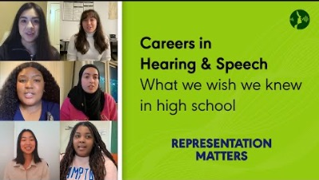
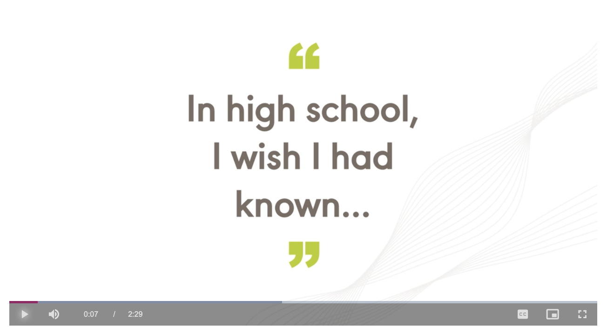

Featuring: Christina Aguilar, Grad Student in Speech-Language Pathology, Linnette Luna, Doctoral Student in Audiology,
Bernice Dinh, Grad Student in Speech-Language Pathology, Amara Ezenwa, Doctoral Student in Audiology,
Jori Childs, , Doctoral Student in Audiology, Shamine Alves, Undergraduate Student in CSD, Sana Ghori, MS, SLP-CF
Notes:
Listen to what these students wish they knew before they decided on a career in CSD.

Slide 4

Picture Yourself Making a Difference
By serving your community
By improving quality of life
By providing clinical services, conducting research, supervising, or managing services
Nearly 1 in 12 children ages 3–17 has
a disorder related
to voice, speech, language, or swallowing.
Notes:
These careers offer so many benefits and opportunities. Not only does CSD offer many areas of employment, but these careers also help serve the needs of your community and improve quality of life.
Add a diverse image

Slide 5



Benefits to a Career in CSD
Earn a good living with excellent benefits and job security.
Job availability is excellent, especially for professionals who are male, who are bilingual, and/or who are from underrepresented backgrounds.
U.S. News & World Report highly ranks audiology and speech-language pathology among best jobs.
Notes:
These are just a few of the benefits you get as an audiologist or speech-language pathologist.
Salaries are competitive and vary depending on education, experience, work setting and geographical location
There is a high demand for clinicians who look like their clients and can communicate in a given client’s language—and this has created a need for more clinicians who are male, who are racially diverse, and who can speak more than one language.
These careers are ranked annually as one of the best health care careers. Although CSD careers are not as well known as other allied health careers, there is a great need for audiologists and SLPs.

Slide 6


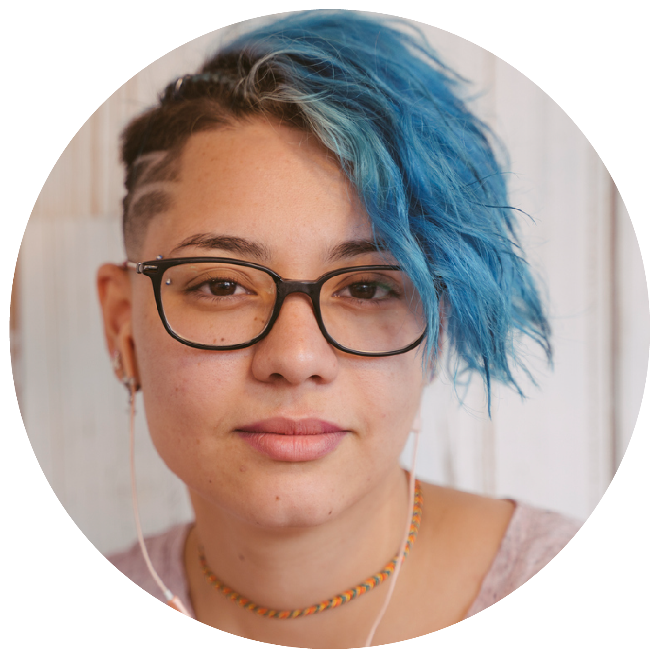

Who You’ll Work With
Babies
Children
Teens
Adults
  In other words . . . people of all ages!
Notes:
Presenter: Please discuss the population that you work with or have worked with and the differences.

Slide 7

Where You’ll Work
and What You’ll Do
Colleges and universities
Corporations
Health care
Industry
Private practice
Research labs
Schools
Give a baby the opportunity to hear their mom’s voice for the first time
Develop groundbreaking research
Work with someone to regain their speech after a stroke
Help someone with hearing disabilities regain their hearing
Notes:
Presenter: Please discuss your current work setting or other settings that you worked in – a day in your life
Presenter: Please discuss some of your cases/clients and how you helped someone to improve their communication.
Many geographic areas have positions that offer flexibility to work with people of any age and in various settings—from universities and research labs to corporations to rural and urban settings.

Slide 8
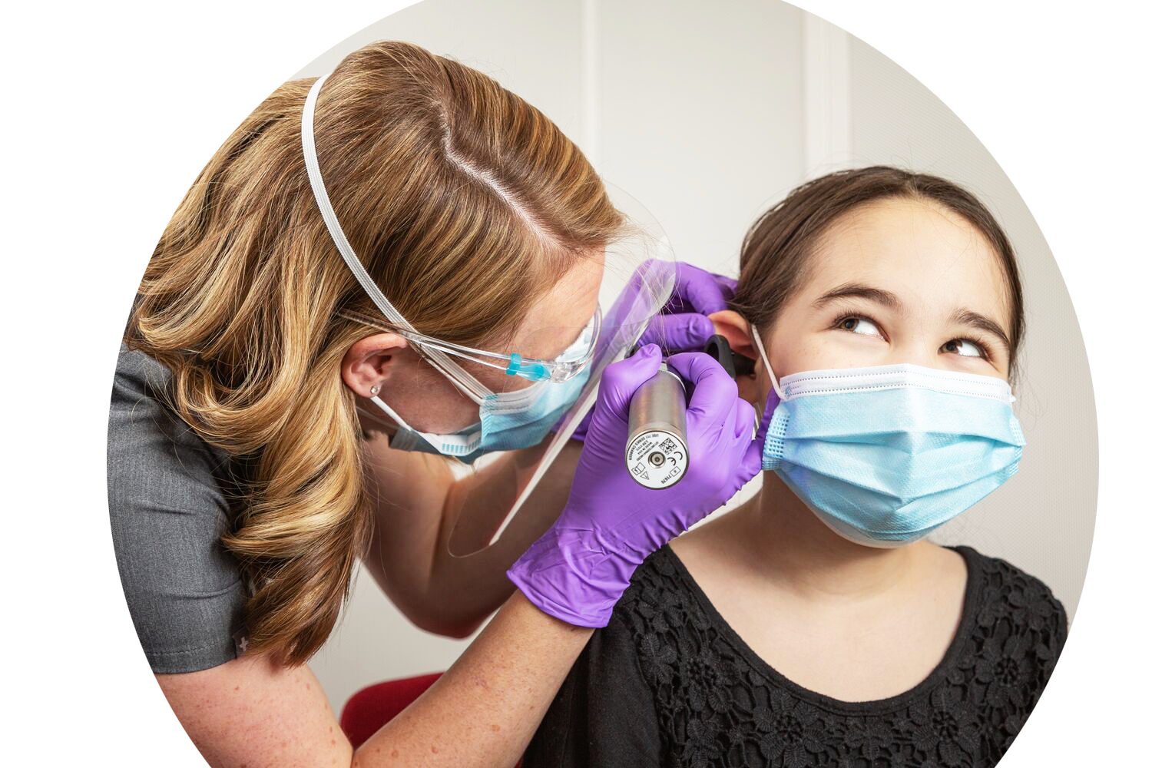

What is an Audiologist?
Audiologists are health care professionals who provide patient-centered care in the prevention, identification, diagnosis, and evidence-based treatment of hearing, balance, and other auditory disorders for people of all ages.
Hearing loss is the third most common physical condition after arthritis and heart disease.*
Notes:
Presenter: Please share why you chose audiology as your career.

Slide 9
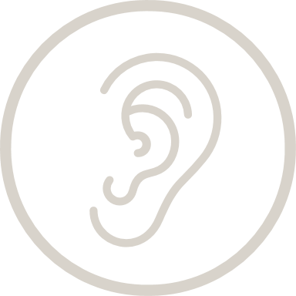
Audiologists have a lot of options
Medical team−including medical specialists, speech-language pathologists, educators, engineers, and scientists.
Clinic or private practice serving clients with hearing loss.
College professor to train the next generation of clinicians.
Develop leading research that changes the ability to communicate.
Educate other audiologists on technology and testing equipment.
Develop programs to protect people’s hearing in the workplace.
Notes:
There are so many opportunities to explore as an audiologist. Think about what interests you: Do you want to work in a health care setting, or be a business owner, or maybe a teacher? If you said yes to any one of those, you can be all those things as an audiologist.

Slide 10
Why an Audiology Career
1 in 5 teens suffers from hearing loss.
3 in 5 veterans returning from war suffer from hearing loss.
Those with even mild hearing loss are twice as likely to develop dementia.
736,900 cochlear implants have been performed worldwide.
More than 90% of deaf children are born to hearing parents.
Men are more likely than women to report having hearing loss.
Notes:
There is a great need for audiologists—especially for those who are male, underrepresented, and/or bilingual—to address these hearing-related disorders. Employment of audiologists is projected to grow 16% through 2030, much faster than the average for all occupations.
Any sound that is loud enough and lasts long enough can damage hearing and lead to hearing loss. The effects of noise that can cause hearing loss varies among people. Many everyday items contribute to hearing loss: loud music, lawnmowers, vacuum cleaners, restaurants, heavy traffic, subway noise, and concerts−among many other items. You can protect your hearing by monitoring noise and volume levels.

Slide 11
Salary Information for Audiologists
Note: In addition to salary, other employee benefits are usually very competitive.
Notes:
Salaries of audiologists vary depending on education, experience, work setting, and geographical location.
Column 1 – salary by degree
Column 2 – salary by type of job
Column 3 – salary by gender

Slide 12
To be an ASHA-certified audiologist, you need to . . .
1. Earn a bachelor’s degree
2. Earn an AuD degree
3. Complete an externship
4. Pass national exam
Notes:
A clinical doctoral degree (AuD) is required to work independently as an audiologist.
An AuD requires approximately 3–4 years of full-time study.
Degree requirements include both academic coursework and clinical practicum experiences.

Slide 13
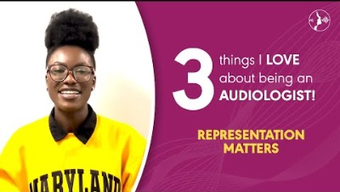
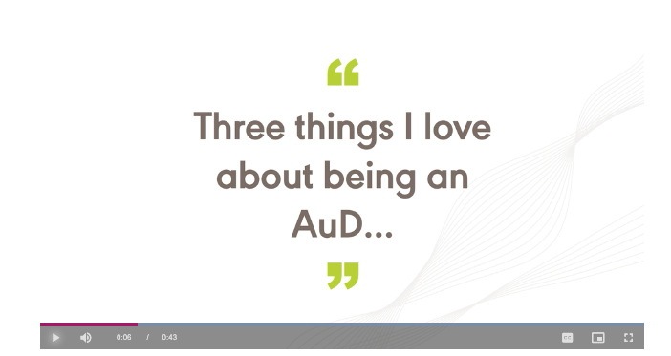
Three Things I’m Looking Forward to When I become an Audiologist
Featuring Amara Ezenwa, AuD, Student
Notes:
Amara is currently studying audiology, and she is looking forward to three things when she becomes a professional.

Slide 14
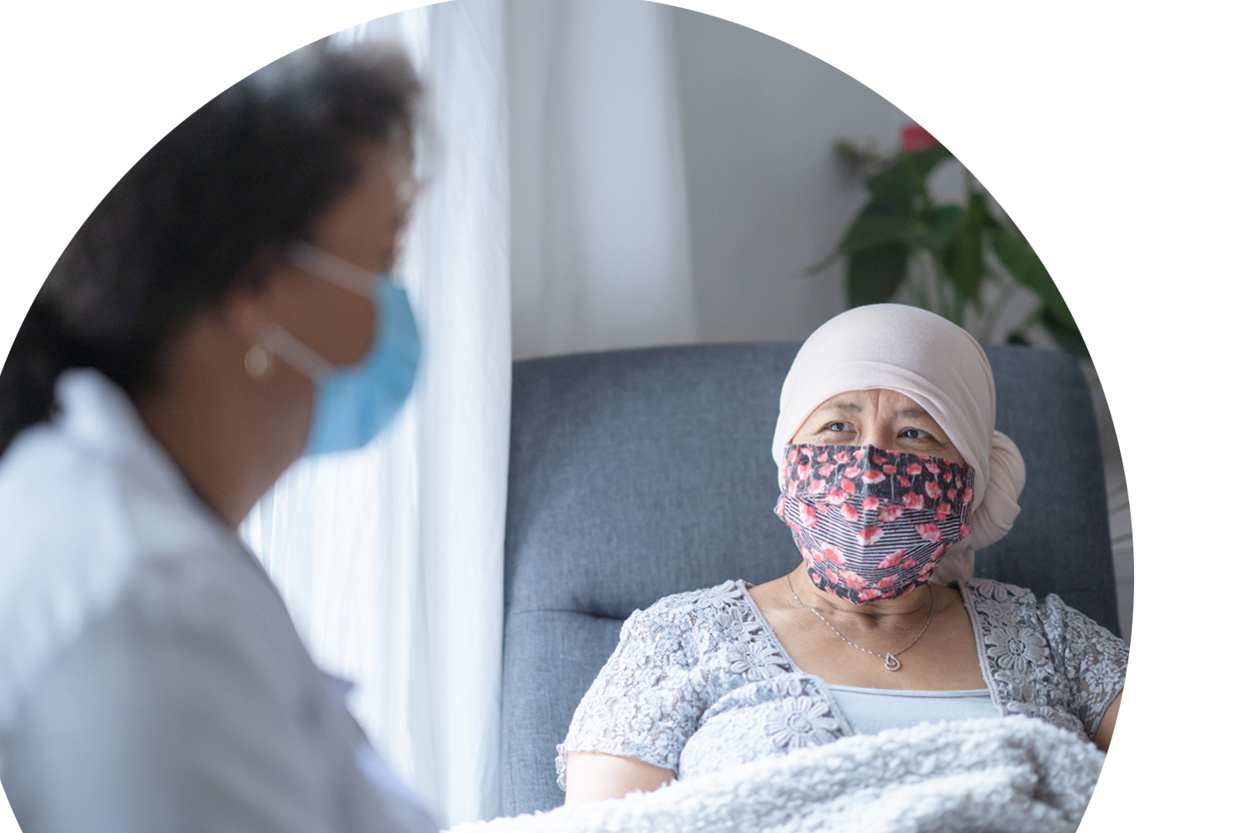
What is a speech-language pathologist?
Speech-language pathologists are health care professionals who identify, assess, and treat speech, language and swallowing disorders preventing and treating communication disorders in people of all ages.
Speech-language pathology is projected to grow 25% through 2029. Much faster than the average (4%) for all occupations.
Notes:
Presenter: Please share why you chose speech-language pathology as your career.

Slide 15

SLPs have a lot of options
Manage a university or hospital speech and hearing clinic.
Serve patients in their private practice.
Be an innovator who develops new methods and equipment to evaluate communication and related problems.
Help employees improve communication with customers.
Help musicians and singers maintain their voice.
Work as a college professor to train the next generation of clinicians.
Notes:
Just like audiologists, SLPs have a lot of options, too. Most SLPs work in the schools, but you can do so much more. You can develop technology, new methods, or equipment to move the discipline forward. You can work in a corporate setting helping individuals improve their communication. You can help musicians and singers maintain their voice. In this career, you can engage in a wide range of employment options.

Slide 16
Why a career in
speech-language pathology?
About 930,000 people in the United States have Parkinson’s disease.
Approximately 17.9 million adults in the U.S. have trouble using their voices.
In the United States, about 3 million people stutter.
Nearly 1 in 10, or 9.6%, of Black children (ages 3–17) has a voice, speech, language, or swallowing disorder—compared to 7.8% of White children and 6.9% of Hispanic children.
Source: NIDCD, 2021
Notes:
There is a great need for SLPs to address these speech-related disorders—especially for those who are male, underrepresented, and/or bilingual. Employment of SLPs is projected to grow 29% through 2030, much faster than the average for all occupations.

Slide 17
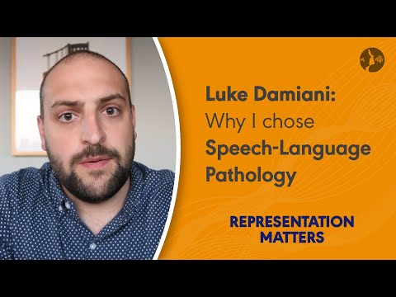
Why I Chose Speech-Language Pathology
Featuring: Luke Damiani, Graduate Student, Speech-Language Pathology
Notes:
Luke is enrolled in a SLP graduate program. Here is why he decided to pursue a career as a speech-language pathologist.

Slide 18
Salary Information
for Speech-Language Pathologists in Schools
Note: In addition to salary, other employee benefits are usually very competitive.
Notes:
More than half (51.0%) of SLPs work in schools. Salaries of SLPs vary depending on education, experience, work setting, and geographical location.
Column 1: salary by type of school
Column 2: salary by population size
Column 3: salary by region
Column 4: salary by gender

Slide 19
Salary Information
for SLPs
in Health Care
Note: In addition to salary, other employee benefits are usually very competitive.
Notes:
Most of the remainder (39.9%) work in health care settings, including hospitals as well as residential and nonresidential health care facilities. Salaries of speech-language pathologists vary depending on education, experience, work setting, and geographical location.
Column 1: salary by type of job
Column 2: salary by employment setting
Column 3: salary by geographic region
Column 4: salary by # of years worked

Slide 20
To be an ASHA-certified
speech-language pathologist,
you need to . . .
Earn a bachelor’s degree
Earn a master’s degree from a
CAA-accredited program
Complete a Clinical Fellowship (CF)
Pass national exam
Notes:
A master’s degree (e.g., MA/MS) is required to work independently as a speech-language pathologist.
A master’s degree in speech-language pathology requires approximately 2 years of full-time study.
Degree requirements include both academic coursework and clinical practicum experiences.

Slide 21
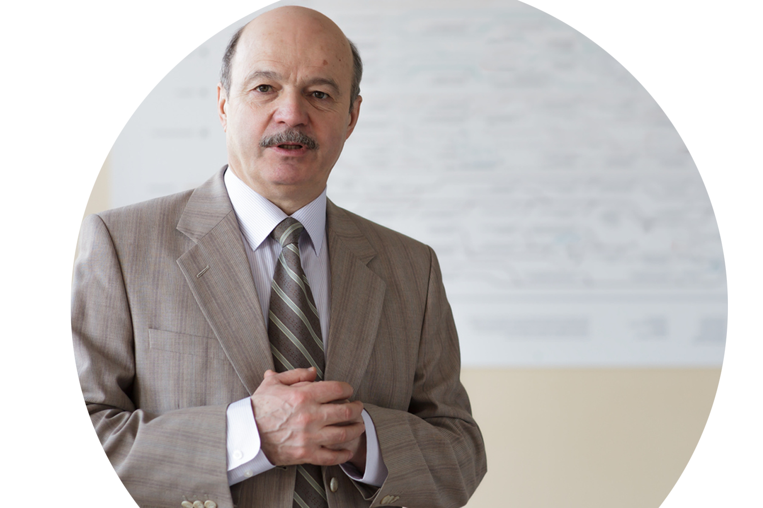
What is a speech, language, and hearing scientist?
Speech, language and hearing scientists are health care professionals who conduct research into the normal functions of human communication, the processes underlying impaired function
and the development of new techniques for assessment
and treatment.
Notes:
Presenter: Please share why you chose speech, language, hearing science as your career.
What you’ll do
What you’ll earn
Who you’ll work with
Where you might work
As a speech, language, and hearing scientist, you will conduct the research that clinicians use to guide their work. You might investigate the biological, physical, and psychological processes of communication. Or you might explore the impact of psychological, social, and other factors on communication disorders. Your work could lead to new methods for diagnosing and treating individuals with speech, language, and hearing problems.

Slide 22
Speech, language, and hearing
scientists have a lot of options
SLPs have a lot of optons
Collaborate with related professionals such as audiologists, SLPs, engineers, physicians, psychologists, and educators to conduct research.
Work as a researcher in communication processes, new treatments, or behavioral patterns associated with communication disorders.
Work as a university professor to train the next generation of clinicians.
Provide consulting services to universities, hospitals, government health agencies,
or industries.
Notes:
As a speech, language, and hearing scientist, you may train the next generate of CSD professionals, conduct research that could make an impact on the professions, or provide consulting services to universities, hospitals, government health agencies, or industries.

Slide 23
The salaries of speech, language, and hearing scientists vary widely depending on experience, work setting, and geographical location. In addition to salary, other employee benefits are usually
very competitive.
Salary Information
for Speech, Language,
and Hearing Scientists
Notes:
There is a great need for scientists and college professors in the CSD discipline—especially those with diverse ethnic and cultural backgrounds.

Slide 24


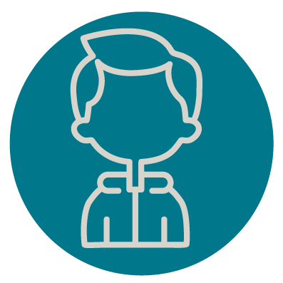
SLPs have a lot of optons
Increase Diversity
ASHA has identified three primary recruitment populations:
Bilingual Service Providers
Individuals from Under-represented
Racial/Ethnic Backgrounds
Males
Notes:
ASHA wants to increase diversity to create a more engaged and empowered membership, improve outcomes and lessen healthcare and educational disparities and an organization that is better able to serve an increasingly diverse constituent base.
In addition, a diverse and inclusive membership cannot exist with the current gender imbalance. Male clinicians are needed in the schools and in the healthcare environment. Increased numbers of male professionals provide more male role models for future generations of men to seek careers in the discipline and will add to the sustainability of the professions.

Slide 25
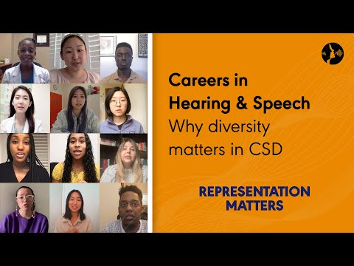

REPRESENTATION MATTERS
Notes:
Don’t underestimate the value that you bring to this discipline because of your unique culture, background, and linguistic skills. As demographics change within the next decade, there will be a growing need for clinicians to serve a more culturally diverse client base.

Slide 26

The need for bilingual clinicians
The top 10 most common languages nationally in health care encounters requiring interpretation are Spanish; languages commonly spoken in China (Mandarin and Cantonese); Vietnamese; Arabic; American Sign Language (ASL); Russian; Portuguese; Haitian Creole; and Korean.
Notes:
If you speak one of the languages listed above, it’s a great chance there is a job waiting for you.
With the changing U.S. demographics, there is a great need for clinicians who speak another language other than English. More than 50 languages other than English are commonly used in daily encounters between patients and health care providers in the United States.

Slide 27
Get started now:
Steps for high school students
Talk to your guidance counselor, the audiologist, or the
speech-language pathologist in your school about a career in CSD.
Visit Information for Students to learn more about
  audiology and speech-language pathology,
  how to plan your education, and
  financial aid.
Order career brochures from ASHA.
Visit the high school roadmap to get started.
Notes:
If you are a high school student interested in a career in communication sciences and disorders (CSD), it’s never too early to start your journey by taking classes, gaining experience, and exploring undergraduate and graduate programs.

Slide 28
Steps for undergraduates preparing for graduate school
Choose a graduate program accredited by the Council on Academic Accreditation (CAA), and review admission and program requirements: www.asha.org/students/edfind/about/
Visit CSD programs, and talk with faculty and students about the curriculum, research interests, and clinical education opportunities. For an even more complete experience, visit the clinics, classrooms, and research labs.
Establish personal criteria to determine what is important to you.
Visit the Undergrad Roadmap to explore the three pathways that will lead you to graduate school.
Notes:
You already know that you need a graduate degree to work as an audiologist or speech-language pathologist.
What are your best options as an undergraduate student? Do you need to major in CSD, or can you get a graduate degree after earning an undergraduate degree in another major?
What courses should you take?
Follow these steps to begin your career in CSD.

Slide 29
Identify undergraduate and graduate CSD programs
Visit EdFind (https://find.asha.org/ed/#sort=relevancy) to search institutions and to review admission and program requirements for undergraduate and graduate CSD programs. Browse by a variety of options:
  study-abroad
  online or distance learning
  location
  multicultural or bilingual emphasis
  Hispanic-serving institutions
  Bilingual-focused institutions, and
  Historically Black Colleges and Universities (HBCUs)

Slide 30

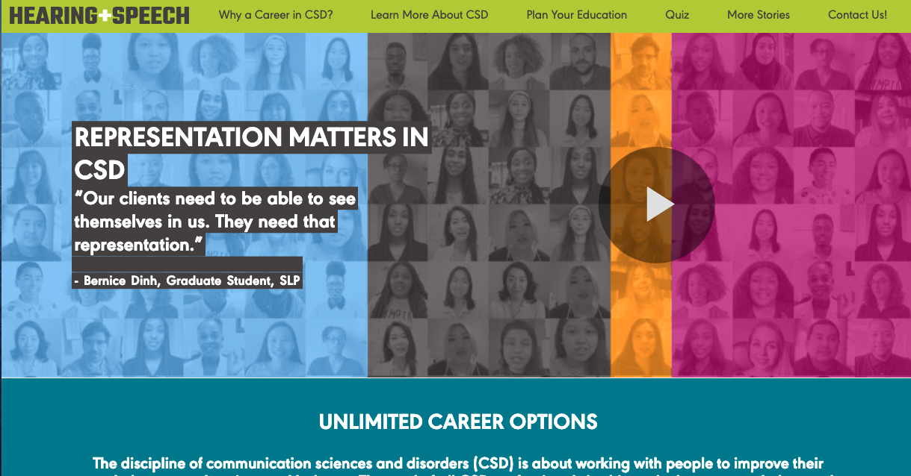
What’s Next?
To learn more about audiology and
speech-language pathology careers,
visit hearingandspeechcareers.org to
view the stories of CSD students and professionals
take the quiz to find out which career
path is best for you
view/print out the roadmap(s)
order career brochures, and
sign up for more information.
Notes:
Now that you’ve learned what CSD is, what should you do next?

Slide 31

ABOUT ASHA
The American Speech-Language-Hearing Association (ASHA) is the national professional, scientific, and credentialing association for 223,000 members and affiliates who are audiologists; speech-language pathologists; speech, language, and hearing scientists; audiology and speech-language pathology support personnel; and students. Visit us at
www.asha.org

Slide 32
THANK YOU FOR ATTENDING TODAY!
Presenter Contact Information
More questions: Send an email to careers@asha.org
Notes:
Presenter: Please add your contact information

