Slide 1
Is an OTC Hearing Aid Right for Me?
An overview of the importance of hearing loss treatment and a quick guide to selecting the best type of hearing device

Slide 2
Audiologist Name & Credentials
Meet Your Local Audiologist
Clinic Information
Professional Accolades or Disclosures
Other sub information to fit under the above headline.
Customizable
[Insert Your
Picture Here]

Slide 3
What Is an Audiologist?
Audiologists are health care professionals working to prevent, diagnose, and manage hearing and balance disorders for people of all ages.
An audiologist has a master’s or doctoral degree and over 1,800+ hours of clinical training.
Audiologist and Hearing Aid Dispenser: What Is the Difference?

Slide 4
Prevalence of Hearing Loss
Increases with age
1─3 of every 1,000 babies born in the U.S. have hearing loss
Approximately 15% of adults 18+ report difficulty hearing
˃ 80% of individuals 80+ have some degree of hearing loss¹
Hearing loss is the 3rd most common chronic physical condition in the U.S.²
million
38.2
Americans aged 12 years or older have hearing loss¹
Notes:
¹ Goman, A. M., & Lin, F. R. (2016). Prevalence of hearing loss by severity in the United States. American Journal of Public Health, 106(10), 1810─1822.
² Masterson, E. A., Bushnell, P. T., Themann, C. L., & Morata, T. C. (2016). Hearing impairment among noise-exposed workers—United States, 2003─2012. Morbidity and Mortality Weekly Report (MMWR), 65(15), 389─394.

Slide 5
Why Is Treatment Important?
Untreated hearing loss is linked to cognitive decline, dementia, falls, social isolation, and depression. It can also affect quality of life at home and work.
Individuals with hearing loss are at increased risk of developing dementia, compared to those without hearing loss.³
On average, adults wait about 7 years to pursue treatment for a hearing loss
Only 20%─30% of adults with hearing difficulties wear a hearing aid.
Notes:
³ The Lancet Commission. (2020). Dementia prevention, intervention, and care: 2020 report of the Lancet Commission.

Slide 6
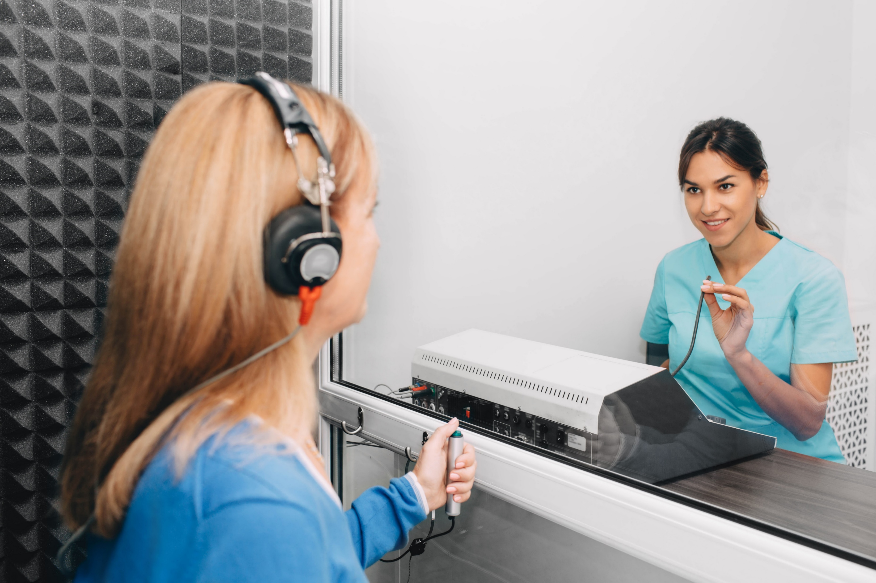
First Step: Consult an Audiologist
Do you have concerns about your hearing? Get tested by a licensed audiologist. This is the best first step, even if planning to buy an OTC hearing aid.
The audiologist will check for common medical causes of hearing loss, like too much earwax.
They will perform a hearing evaluation to check for hearing loss. If you are experiencing hearing loss, they will describe severity, type, and options.

Slide 7
Functional Communication Assessment
An audiologist will perform a functional communication assessment. Together, you can decide what type of treatment is best for your hearing levels and lifestyle. If a hearing aid is recommended, the audiologist will suggest what type of device is most appropriate.
over-the-counter (OTC) hearing aid
prescription hearing aid

Slide 8
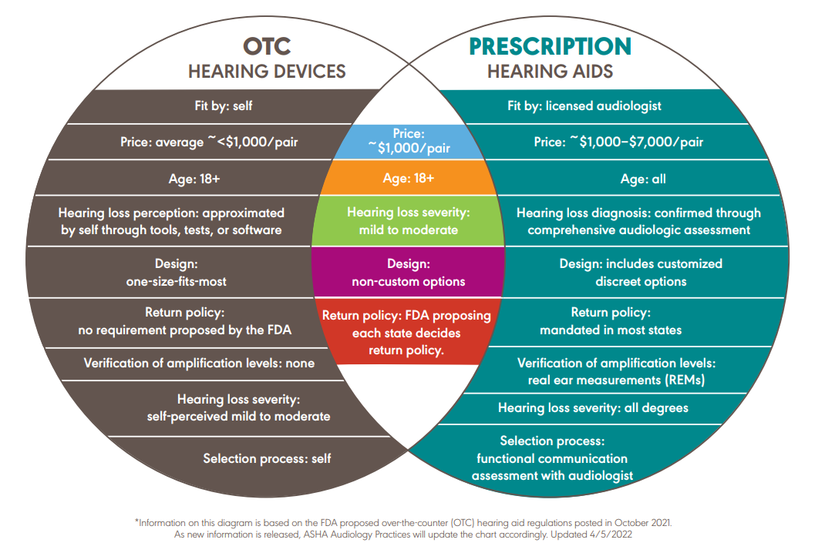
OTC vs. Prescription Hearing Aid: What Is the Difference?

Slide 9
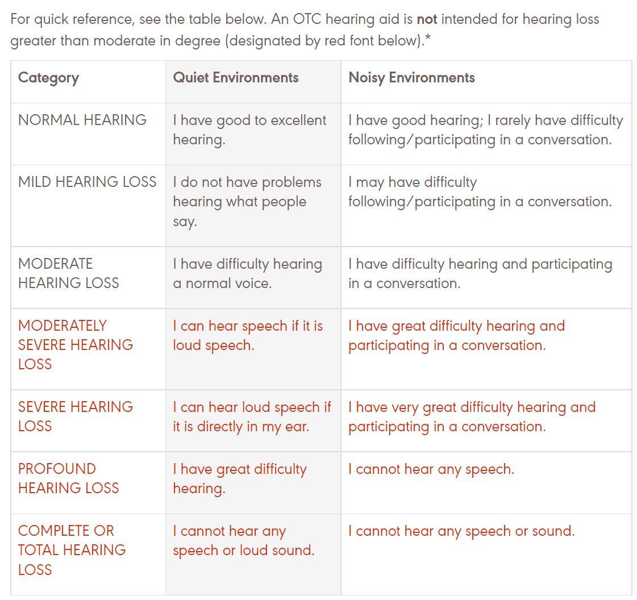
Who Is a Candidate for OTC Hearing Aids?
Adults 18+
Perceived mild-to-moderate hearing loss

Slide 10
Audiology Referral Required

Slide 11
Where Do I Buy an OTC Hearing Aid?
Local pharmacies, large retail chains, and online providers may sell OTC hearing aids.
It is important to read all the information on the “box” before buying a device; you may not be able to return it.
Many audiologists will still be able to help you with basic maintenance of these devices for a service fee.

Slide 12
When to Stop Using an OTC Hearing Aid
?

Slide 13
Questions?
Concluding remarks
Contact information

