Slide 1
ASHA Over-the-Counter (OTC) Hearing Aid Toolkit
A Quick Reference for Primary Care Physicians

Slide 2

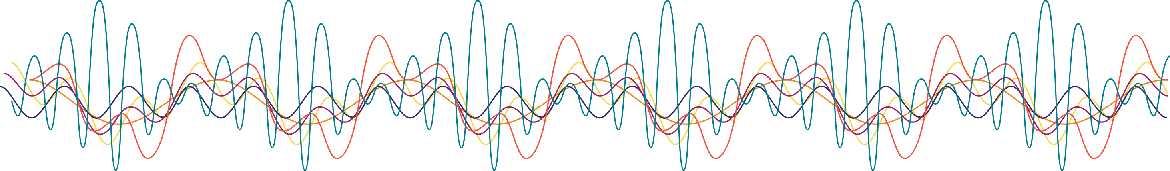
Your Information Here
Customize introduction page
Insert your photo
Job title and credentials
Clinic contact information

Slide 3
Hearing Loss and Public Health Facts
Globally, the total economic cost of hearing loss exceeded $981 billion in 2021, which included quality-of-life losses and financial costs of poor health in those with hearing loss.
– WHO, 2021
In the United States, untreated hearing loss is estimated to cost between $1.8 billion and $194 billion in lost productivity and between $3.3 and $12.8 billion in direct medical costs (Huddle, 2017).
46% of adults who reported hearing difficulty had seen a health care provider for their hearing in the past 5 years.
– CDC, 2020

Slide 4
Hearing Loss and Public Health
Incident Hearing Loss and Comorbidity
Purpose of the study: A retrospective study to investigate the connection between hearing loss and comorbidities in adults 50 years or older.
Results: At the 10-year mark, patients with untreated hearing loss experienced about 50% more hospital stays, had about a 44% higher risk for hospital readmission within 30 days, were 17% more likely to have an emergency department visit, and had about 52 more outpatient visits compared with those without hearing loss.
The greatest relative increase in risk was estimated for dementia and depression, with hearing loss being associated with an approximately 50% increase in both conditions over 5 years.
Source: Deal et al. (2019).

Slide 5
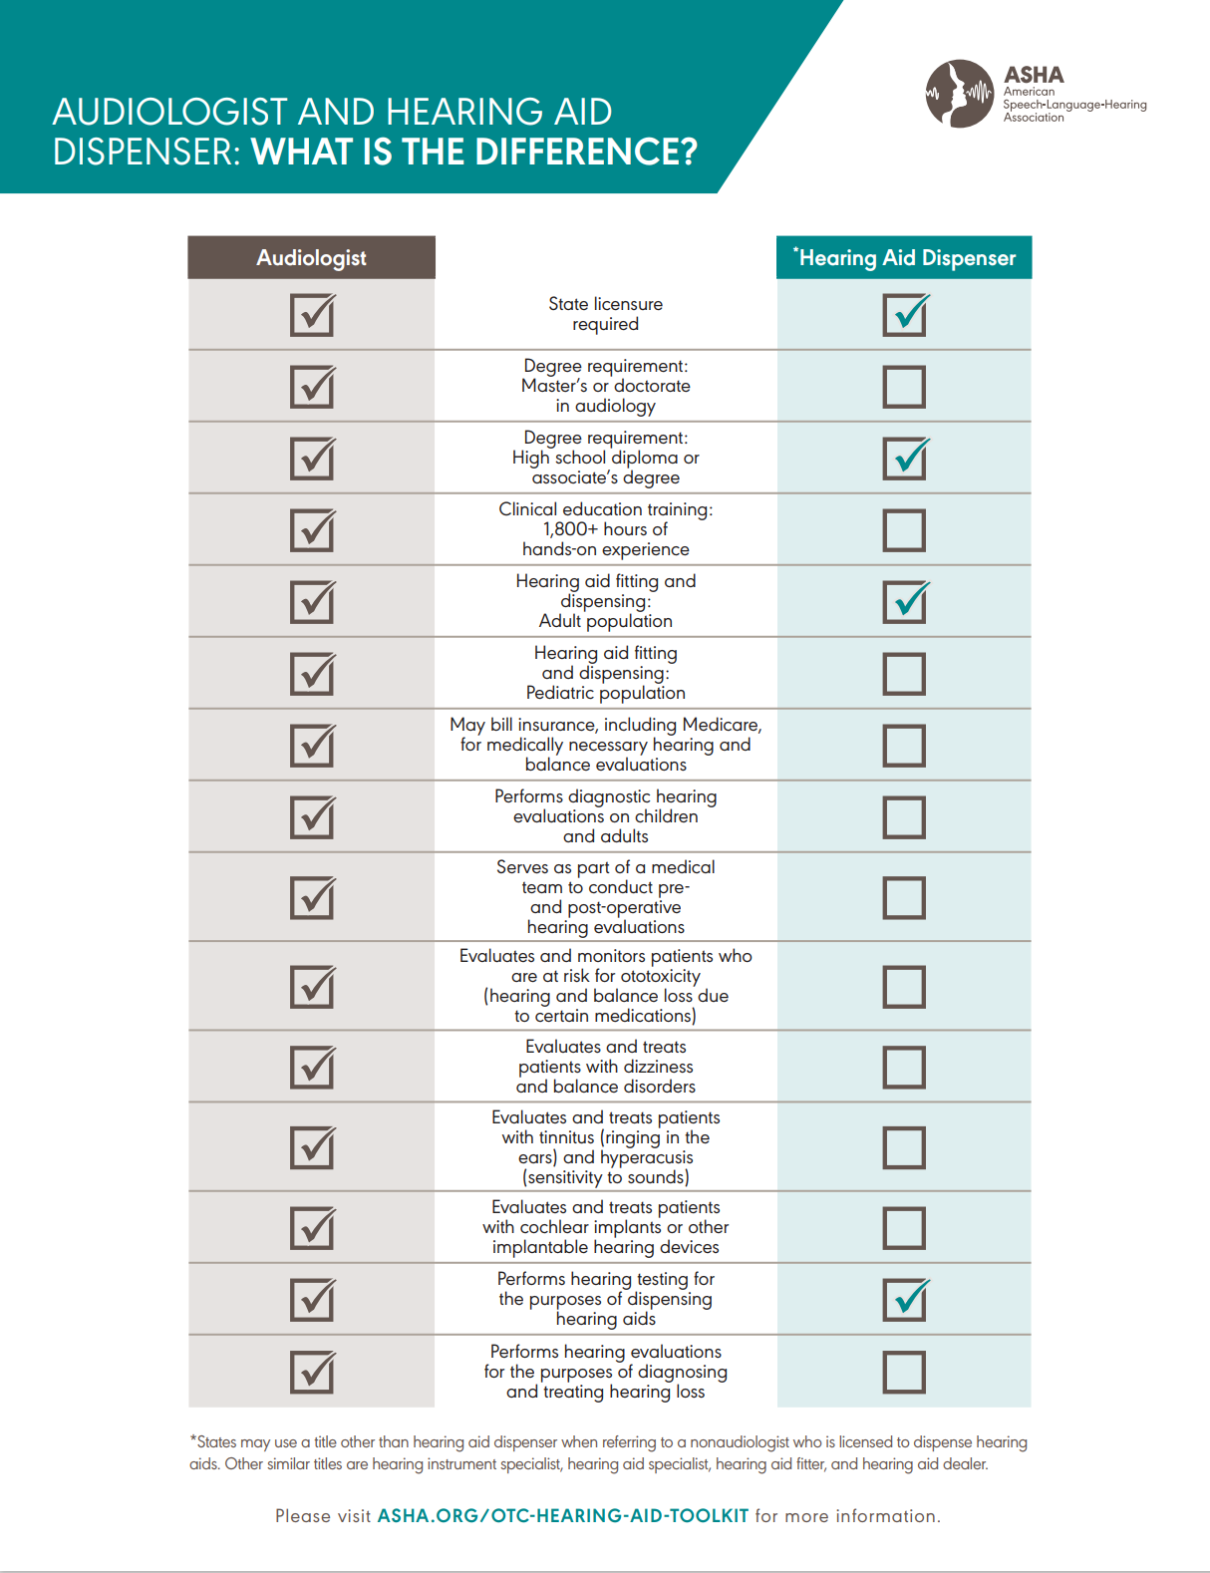
How Can Physicians Help Patients with their Hearing?
Refer them to hearWHO, an easily accessible, in-office hearing screening tool that uses a smart device and a pair of headphones. This easy, quick tool (screening takes about 3 min) is an option that anyone can use.
Refer them to an audiologist if they fail their screening. An audiologist will provide a comprehensive hearing evaluation.
Encourage them not to put off hearing loss evaluation and treatment.
Share ASHA’s What Is the Difference? document, which compares audiologists with hearing aid dispensers.

Slide 6
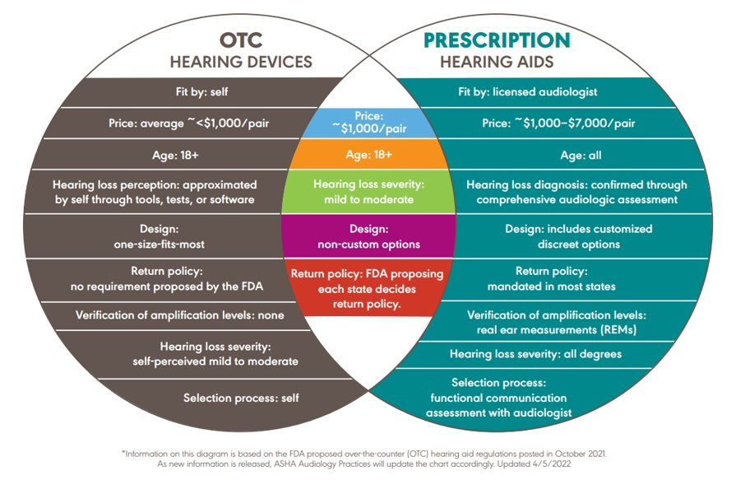
Types of Hearing Aids

Slide 7
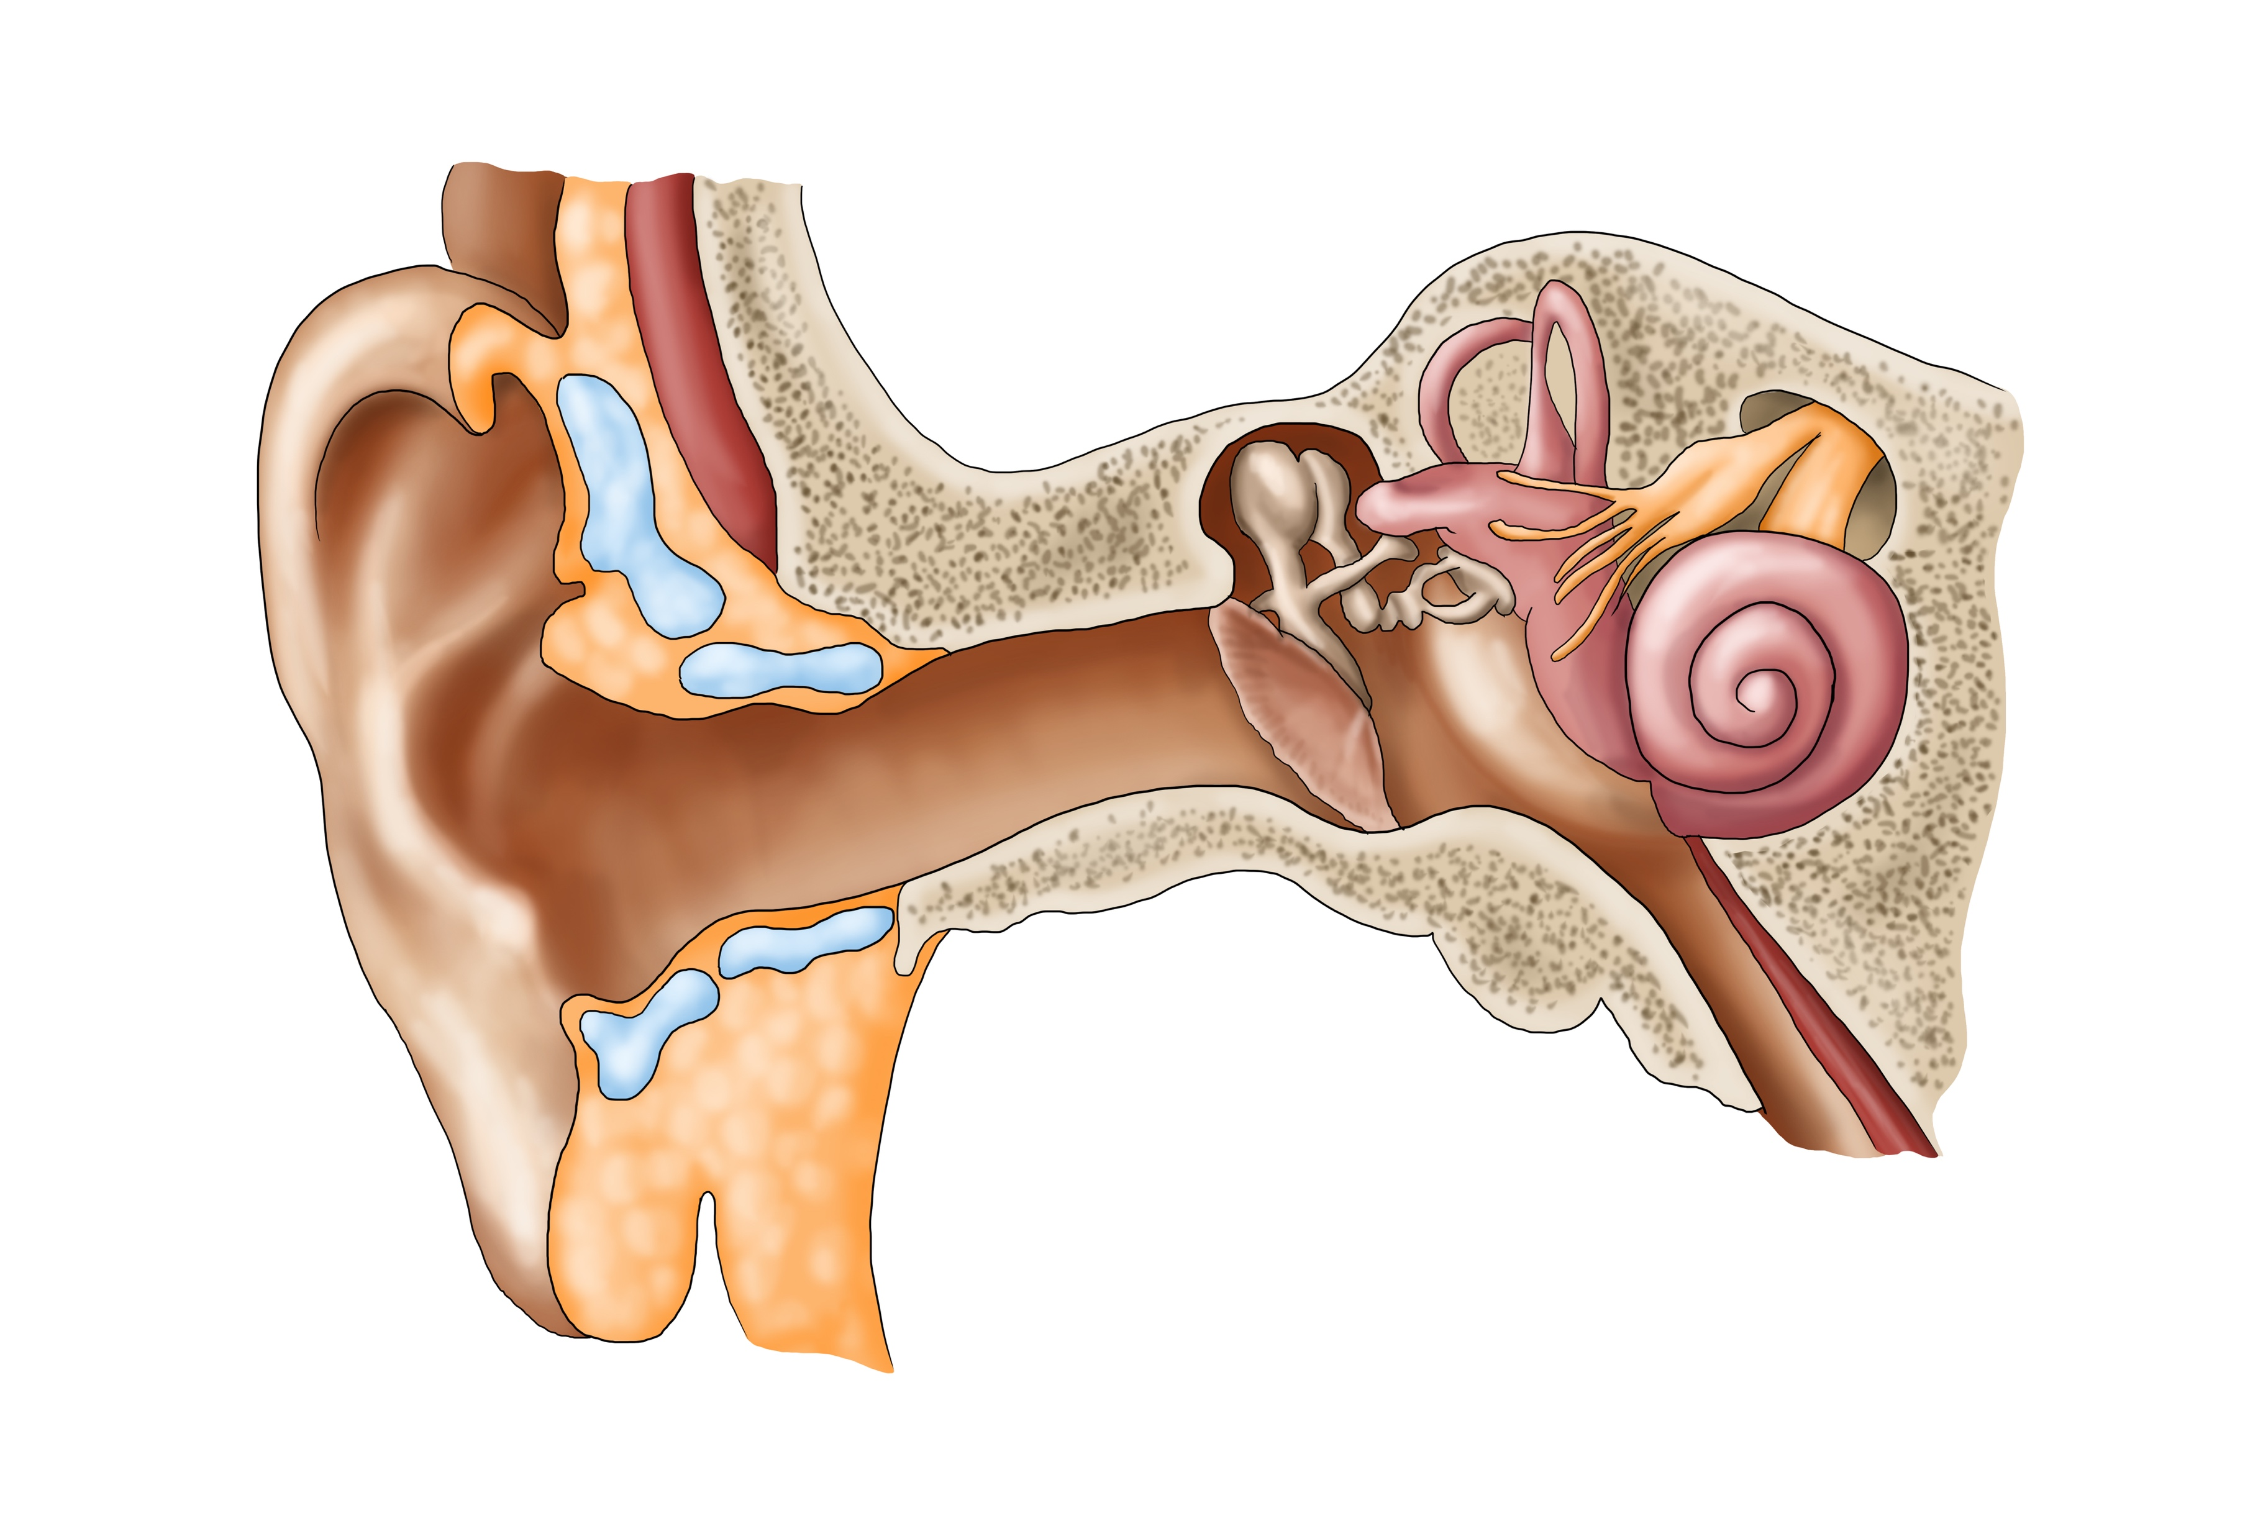
OTC Hearing Aids
The U.S. Congress passed legislation in 2017 requiring the U.S. Food and Drug Administration (FDA) to develop regulations for over-the-counter (OTC) hearing aids. The intent of the legislation was to offer adults with perceived mild-to-moderate hearing loss the opportunity to purchase a device on their own at a lower cost.
OTC hearing aids:
  Are meant for individuals with perceived mild-to-moderate hearing loss.
  Are intended for individuals aged 18 years and older.
  Do not require a hearing evaluation.
  Have a “one-size-fits-most” design.
  May reduce barriers to hearing health care.

Slide 8
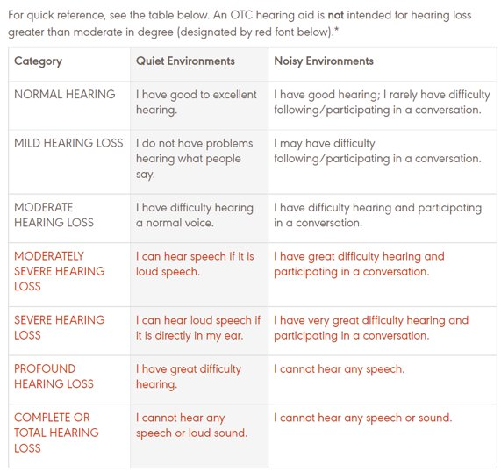
Who is a Candidate for OTC Hearing Aids?
89%
Here is a small statistic call out.

Slide 9
Pros and Cons of OTC Hearing Aids
PROs
CONs
An individual can purchase OTC hearing aids without visiting a medical professional.
Cost will likely be lower; current estimates show that a pair of OTC hearing aids will cost under $1,000.
There is the potential for over- or under-amplification as OTC devices do not require a hearing evaluation.
No formal hearing evaluation is needed to obtain OTC devices. Ear-related medical complications may go undiagnosed.
OTC devices come with no follow-up care or rehabilitation plan.
No professional will be monitoring hearing levels over time or troubleshooting OTC device issues.
There is no use of verification or best practices for hearing aid fitting and follow-up.
Few customizable options are available—thus, limited opportunities exist for person-centered care.
Accessibility and cost may entice more people with hearing loss to explore options for treatment.
OTC devices can be good “starter hearing aids” for adults with a mild-to-moderate level of perceived hearing loss.

Slide 10
Summary
The popularity of direct-to-consumer and Internet sales have made it easier for consumers to access potentially useful medical treatment. For the safety of individuals seeking hearing treatment—including OTC hearing aids—please encourage them to seek a hearing evaluation by a licensed audiologist for appropriate guidance and hearing health care.

Slide 11
Resources and References
Centers for Disease Control and Prevention. (2020, January 6 ). Too Loud! For Too Long! Vital Signs. https://www.cdc.gov/vitalsigns/hearingloss/index.html.
Deal, J. A., Reed, N. S., Kravetz, A. D., Weinreich, H., Yeh, C., Lin, F. R., & Altan, A. (2019). Incident hearing loss and comorbidity: A longitudinal administrative claims study. JAMA Otolaryngology–Head & Neck Surgery, 145(1), 36–43. https://doi.org/10.1001/jamaoto.2018.2876
Gray, J. D. (Host). (2021, September 30). Research sheds light on the hearing loss–cognition link [Audio podcast episode]. In ASHA Voices. American Speech-Language-Hearing Association. https://leader.pubs.asha.org/do/10.1044/2021-0930-podcast-research-symposium-2021/full/
hearWHO – Free screening tool to identify who should be referred to an audiologist for a comprehensive hearing evaluation.
Huddle, M.G., A.M. Goman, F.C. Kernizan, D.M. Foley, C.Price, K.D. Frick, F.R. Lin, et al. (2017). The Economic Impact of Adult Hearing Loss: A Systematic Review. JAMA Otolaryngology- Head & Neck Surgery 143 (10): 1040–1048.
National Institute on Deafness and Other Communication Disorders. (2021, March 25). Quick statistics about hearing. https://www.nidcd.nih.gov/health/statistics/quick-statistics-hearing
World Health Organization. (2021, April 1). Deafness and hearing loss [Fact sheet]. https://www.who.int/news-room/fact-sheets/detail/deafness-and-hearing-loss
U.S Food and Drug Administration ( 2021, October 19). FDA issues landmark proposal to improve access to hearing aid technology for millions of Americans. https://www.fda.gov/news-events/press-announcements/fda-issues-landmark-proposal-improve-access-hearing-aid-technology-millions-americans.
*Information in this PowerPoint presentation was last updated 7/3/2022.
Please refer to Over-the-Counter Hearing Aid Toolkit (asha.org). for updates.

