Slide 1
Over-the-Counter Hearing Aids

Slide 2
Agenda Items
Audiology Scope of Practice
Hearing Loss
Hearing Aids
Over-the-Counter Hearing Aids
Educate. Promote. Collaborate.
Tools for patients
Tools for pharmacists
Tools for physicians

Slide 3
Audiology Scope of Practice
Audiologists are responsible for the assessment and treatment of hearing, balance, and other related disorders across the lifespan. Responsibilities may include the provision of
comprehensive audiologic (re)habilitation services for individuals who are experiencing hearing, balance, or other related disorders;
recommendations for the selection, fitting, and dispensing of hearing devices; and
education to other professionals about the symptoms of hearing loss, the specific needs of persons using hearing devices, and the role of audiologists.
Audiologists should remain informed of federal and state mandates and initiatives that impact individuals with hearing loss.

Slide 4
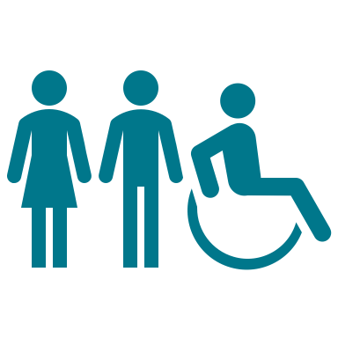
Hearing Loss
Hearing loss is a public health issue. The incidence of hearing loss increases with age. Several health risks are associated with hearing loss:
communication challenges
social isolation
mental health challenges
accelerated cognitive decline
Many people with hearing loss will benefit from the use of hearing technology. The audiologist plays a critical role in health care.

Slide 5
Hearing Aids
Hearing aid: “Any wearable instrument or device designed for, offered for the purpose of, or represented as aiding persons with or compensating for, impaired hearing” (CFR - Code of Federal Regulations Title 21)
Hearing aids are considered medical devices and, as such, are regulated by the U.S. Food and Drug Administration (FDA). The FDA uses a risk-based classification system for hearing-related devices.
CLASS | RISK | REGULATORY REQUIREMENTS | HEARING TECHNOLOGY EXAMPLES
CLASS I | Low | General controls | Air-conduction hearing aids
CLASS II | Moderate | General Controls and Special Controls | Wireless air-conduction hearing aids, bone-conduction hearing aids, tinnitus maskers
CLASS III | High | General Controls and Premarket Approval | Cochlear implants, middle ear implants, auditory brainstem implants

Slide 6
OTC Hearing Aid Legislation Timeline
October 2015: President’s Council of Advisors on Science and Technology (PCAST) recognizes the impact of untreated hearing loss on an aging population. PCAST makes several recommendations, including the creation of a new category of basic hearing aids to be sold over the counter.
2020: COVID-19 pandemic occurs.
August 2017: The FDA Reauthorization Act of 2017 directs the FDA to develop regulations for over-the-counter hearing aids, with the devices to be made available to the public by 2020.
August 2018: Hearing care associations (AAA, ADA, ASHA, IHS) release Regulatory Recommendations for OTC Hearing Aids: Safety and Effectiveness, a consensus paper.
October 2021: the FDA releases proposed rule for OTC hearing aids for adults 18 and older with mild to moderate hearing loss.
August 2022: The FDA releases a final rule establishing a regulatory category for OTC hearing aids. This rule is effective 10/17/2022.

Slide 7
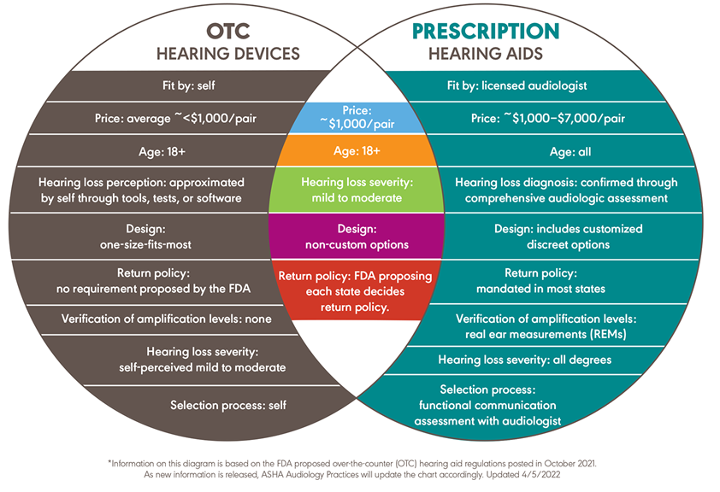
Over-The-Counter Hearing Aids
The FDA has established a new regulatory class of over-the-counter (OTC) hearing aids for adults (18 years and older) with self-perceived mild to moderate hearing loss.
OTC hearing aids are not right for everyone.

Slide 8
ASHA OTC Hearing Aid Toolkit
ASHA is committed to helping audiologists minimize the disruption of OTC hearing aids on their practice and identifying opportunities to raise awareness of audiology. Audiologists can use the ASHA Over-the-Counter Hearing Aid Toolkit to:
educate patients about OTC hearing aids;
promote the continued value of an audiologist; and
collaborate with and market your practice to other trusted professionals influencing OTC hearing aid decisions.

Slide 9
Educate. Promote. Collaborate.

